Slide 1
Project Title
Transport Management System
GROUP MEMBERS
S.No. | Enrollment # | Student Name
1 | 02-131222-090 | Ayesha
2 | 02-131222-097 | Arifa Naseem
3 | 02-131222-088 | Hafsa Shahid

Slide 2
Table of Contents
Introduction
Background
Problem Statement
Proposed Solution
Project Scope
Working Software Demo
References

Slide 3
Introduction
Overview: Transport Management Systems (TMS) are essential for optimizing transportation operations.
Objective: To enhance efficiency, accuracy, and user satisfaction in transportation management.
Key Features: User management, bus information storage, scheduling, ticketing, and revenue calculation.

Slide 4
Background
Current Challenges: Manual scheduling, booking inefficiencies, and passenger management issues.
Industry Needs: A centralized, automated system to manage and streamline transportation operations.
Technological Adoption: Use of SQL Server and MySQL to handle data efficiently.

Slide 5
Problem Statement
Challenges:
Inefficient manual processes in scheduling and booking.
Difficulties in managing passenger information and revenue calculations.
Customer dissatisfaction due to errors and delays.
Impact: Operational inefficiencies and reduced service quality.

Slide 6
Proposed Solution
Solution Overview: The proposed solution is a robust transport management system that automates key tasks involved in managing transportation services. It streamlines operations, enhances accuracy, and improves the overall passenger experience

Slide 7
Features In Proposed Solution
User Management:
Register and manage users.
Secure authentication and role-based access.
Bus Information:
Database of bus details (registration, seating, amenities).
Scheduling:
Route planning and driver assignments.
Real-time updates.
Ticketing:
Online booking with seat selection.
Integrated payment gateways.
Passenger Details:
Track passenger information.
Enhanced reporting and analytics.
Revenue Calculation:
Automated fare and revenue tracking.
Financial reports for agencies.

Slide 8
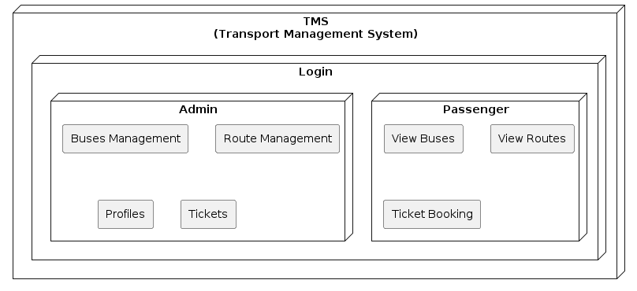
Methodology

Slide 9
Technologies
Database Management Systems:
SQL Server: Primary DBMS.
MySQL: Secondary DBMS.
Development Tools:
SQL Server Management Studio: Manage databases.
Visual Studio: Code and test.
Programming Languages:
SQL: Database operations.
C#: Application development.
Additional Technologies:
Triggers and Stored Procedures: Automate tasks.
APIs: Integrate external services.
UI Technologies: Build responsive interfaces.

Slide 10
Project Scope
Objective: Address transportation management challenges with a comprehensive, user-friendly system.
Target Users: Bus agencies, travel operators, and passengers.
Scalability: Designed to adapt and scale according to evolving needs.
Modules:
Logical Module: Tickets, buses, and route planning.
Scheduling Module: Bus schedules and database management.
View Module: User interface and data visualization.

Slide 11
Working Software Demo...

Slide 12
References
https://ijrpr.com/uploads/V3ISSUE5/IJRPR4070.pdf
https://acropolium.com/blog/transportation-management-software-development-a-detailed-overview/

Slide 13
Thank You!

